Slide 1

Hidden Markov Model
Part 2

Slide 2
Three problems of HMM
Decoding - finding the most likely sequence of states
Evaluation - finding the probability of a given sequence
Training/learning - estimating model parameters

Slide 3
Three problems of HMM
Decoding - finding the most likely sequence of states
Known: O = o₁...o_{n}, 𝜆 = {P(q_{i}), P(q_{j}|q_{i}), P(o|q_{i})}
Find: Q = q₁...q_{n}
Application: sequence labeling
for Raul Salinas de Gortari, brother of a former Mexican president, to banks in Switzerland, are also expected to

Slide 4
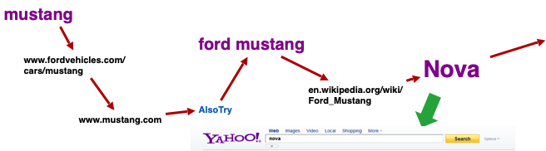
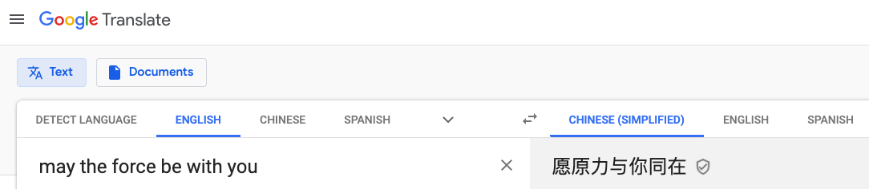
Three problems of HMM
Evaluation - finding the probability of a given sequence
Known: O = o₁...o_{n}, 𝜆 = {P(q_{i}), P(q_{j}|q_{i}), P(o|q_{i})}
Find: P(O|𝜆)
Application: sequence prediction, sequence generation
?

Slide 5


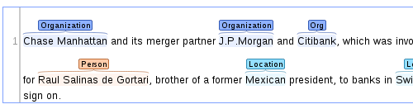
Three problems of HMM
Training/learning - estimating model parameters
Known: {O, Q}, or just O
Find: 𝜆 = {P(q_{i}), P(q_{j}|q_{i}), P(o|q_{i})}
Supervised:
Person
Unsupervised:
Location
None
https://brat.nlplab.org/examples.html

Slide 6
Applications of HMMs
Natural language processing: part of speech tagging, entity/relation extraction, machine translation, ...
Bioinformatics: gene detection, sequence alignment, structure prediction, motif discovery, ...
Speech recognition, signal processing, time series analysis
Behavior analysis: finance, sports, business, transportation, …
More powerful solutions available (deep learning, recurrent neural networks), but HMMs are still widely used as reliable baselines & building blocks for more complex techniques.

Slide 7
Which model is better?
Use data likelihood
If a model (including structure and parameters) is better, then P(O|𝜆) should be larger
Related concepts: perplexity, entropy
In reality, use validation data to evaluate which model is better
Prediction accuracy: precision, recall, F1, cross-entropy

Slide 8



Summary of sequence modeling
https://www.biocompare.com/Molecular-Biology/9187-Next-Generation-Sequencing/
Learning
Applications
Sequence labeling
Sequence prediction
Sequence generation
Sequence alignment
...
Lots of sequences (labeled/unlabeled)
find model parameters
Select a model

Slide 9
What you should know
Sequence modeling provides a solution to sequence prediction and other sequence mining tasks
A family of models compute the probability of any sequence
Markov assumption simplifies the dependency of long sequences
The ideas behind n-gram language models, Markov chain, and hidden Markov models
Hidden Markov models have a lot of applications, although deep learning models are more powerful

Slide 10
Credits: Qiaozhu Mei, Ph.D., Professor of Information
© Faculty Presenter Qiaozhu Mei
Except where otherwise noted, this work is licensed under CC BY-NC 4.0
Notes:
End of part 2

